Slide 1

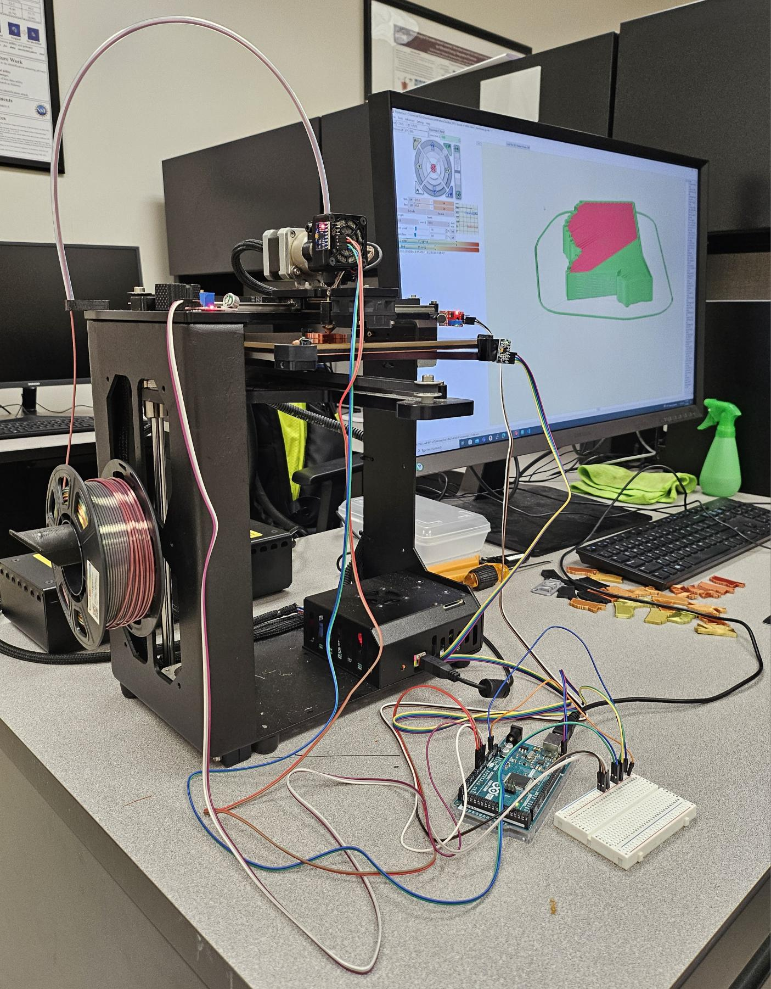
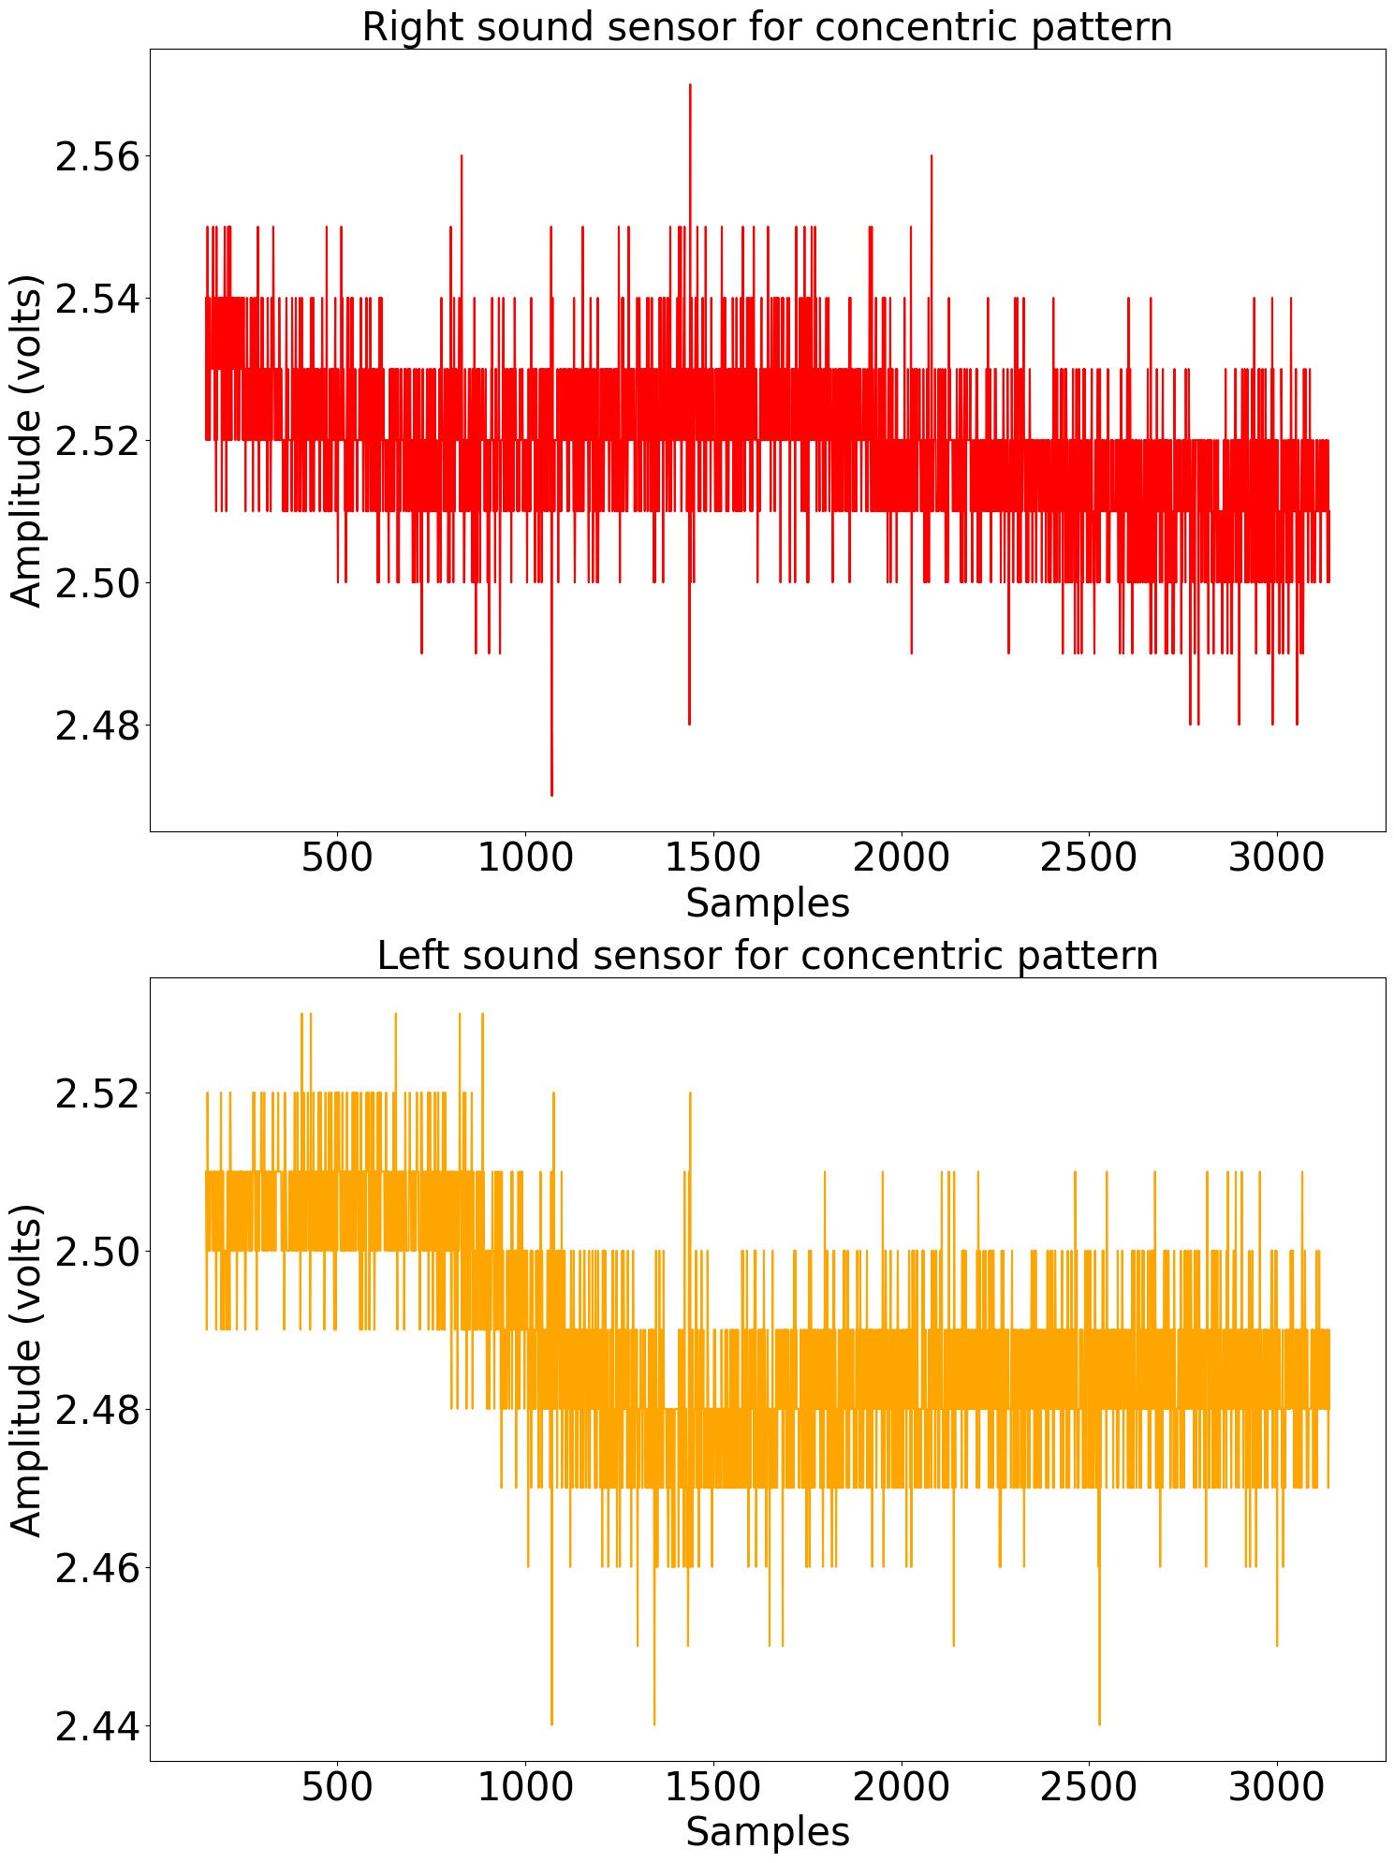
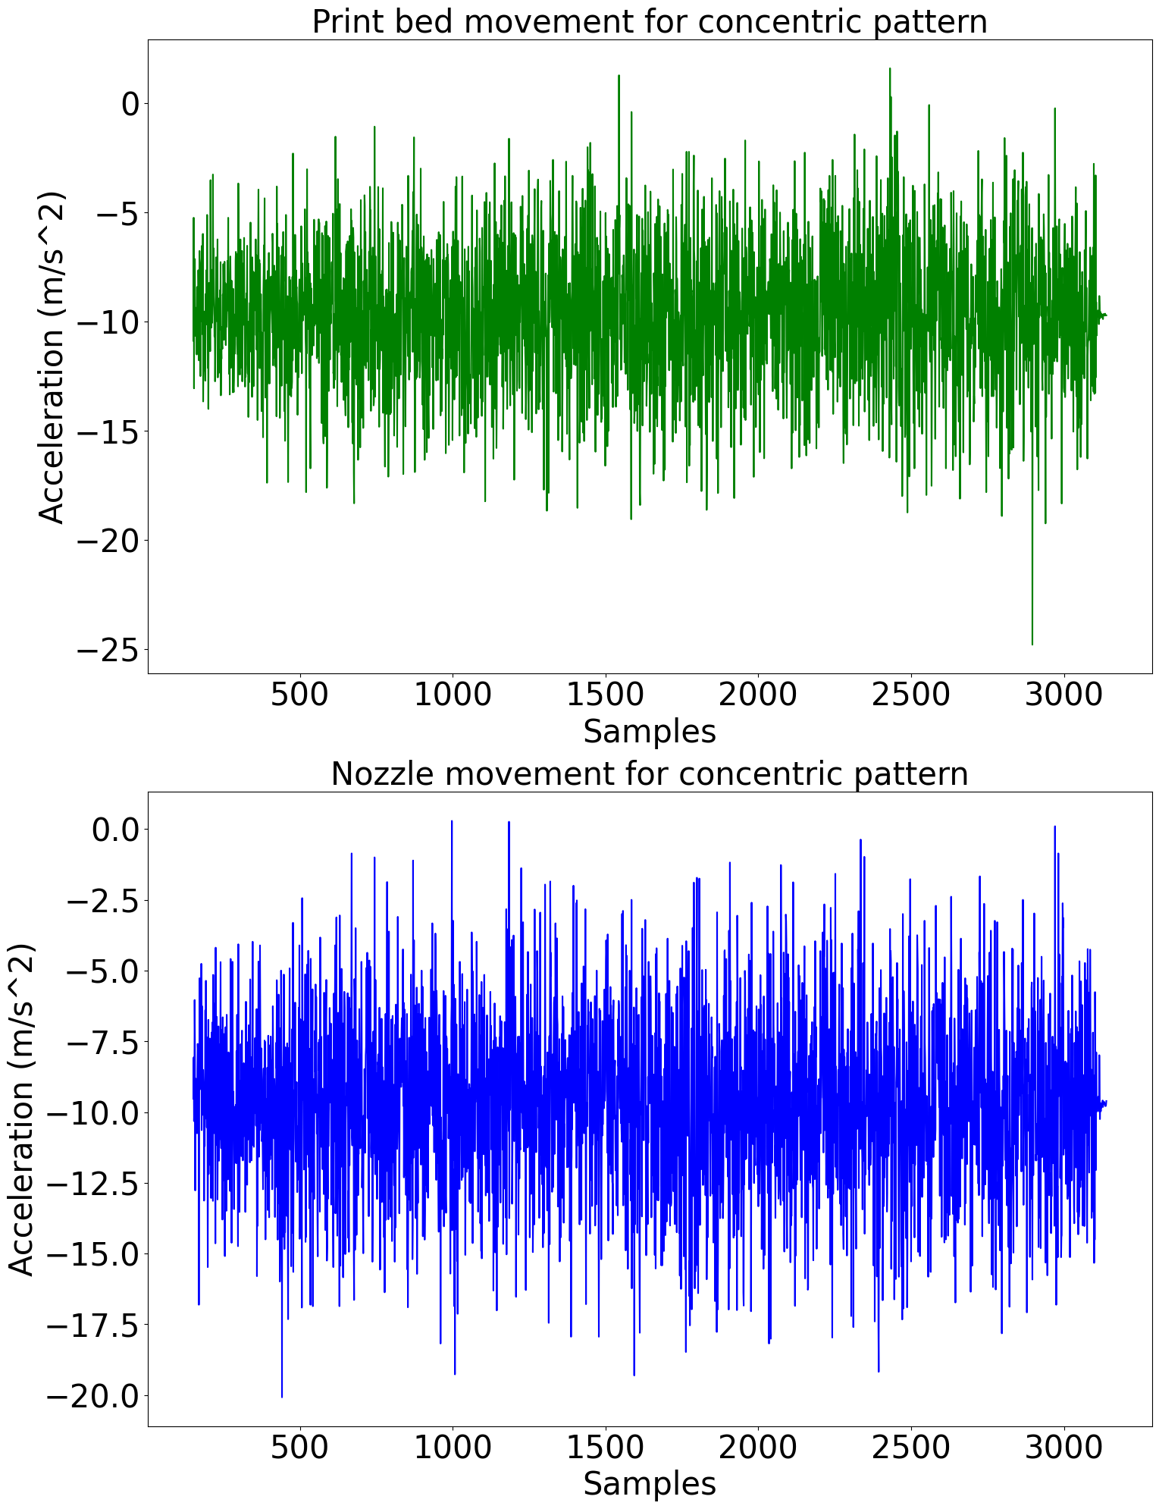
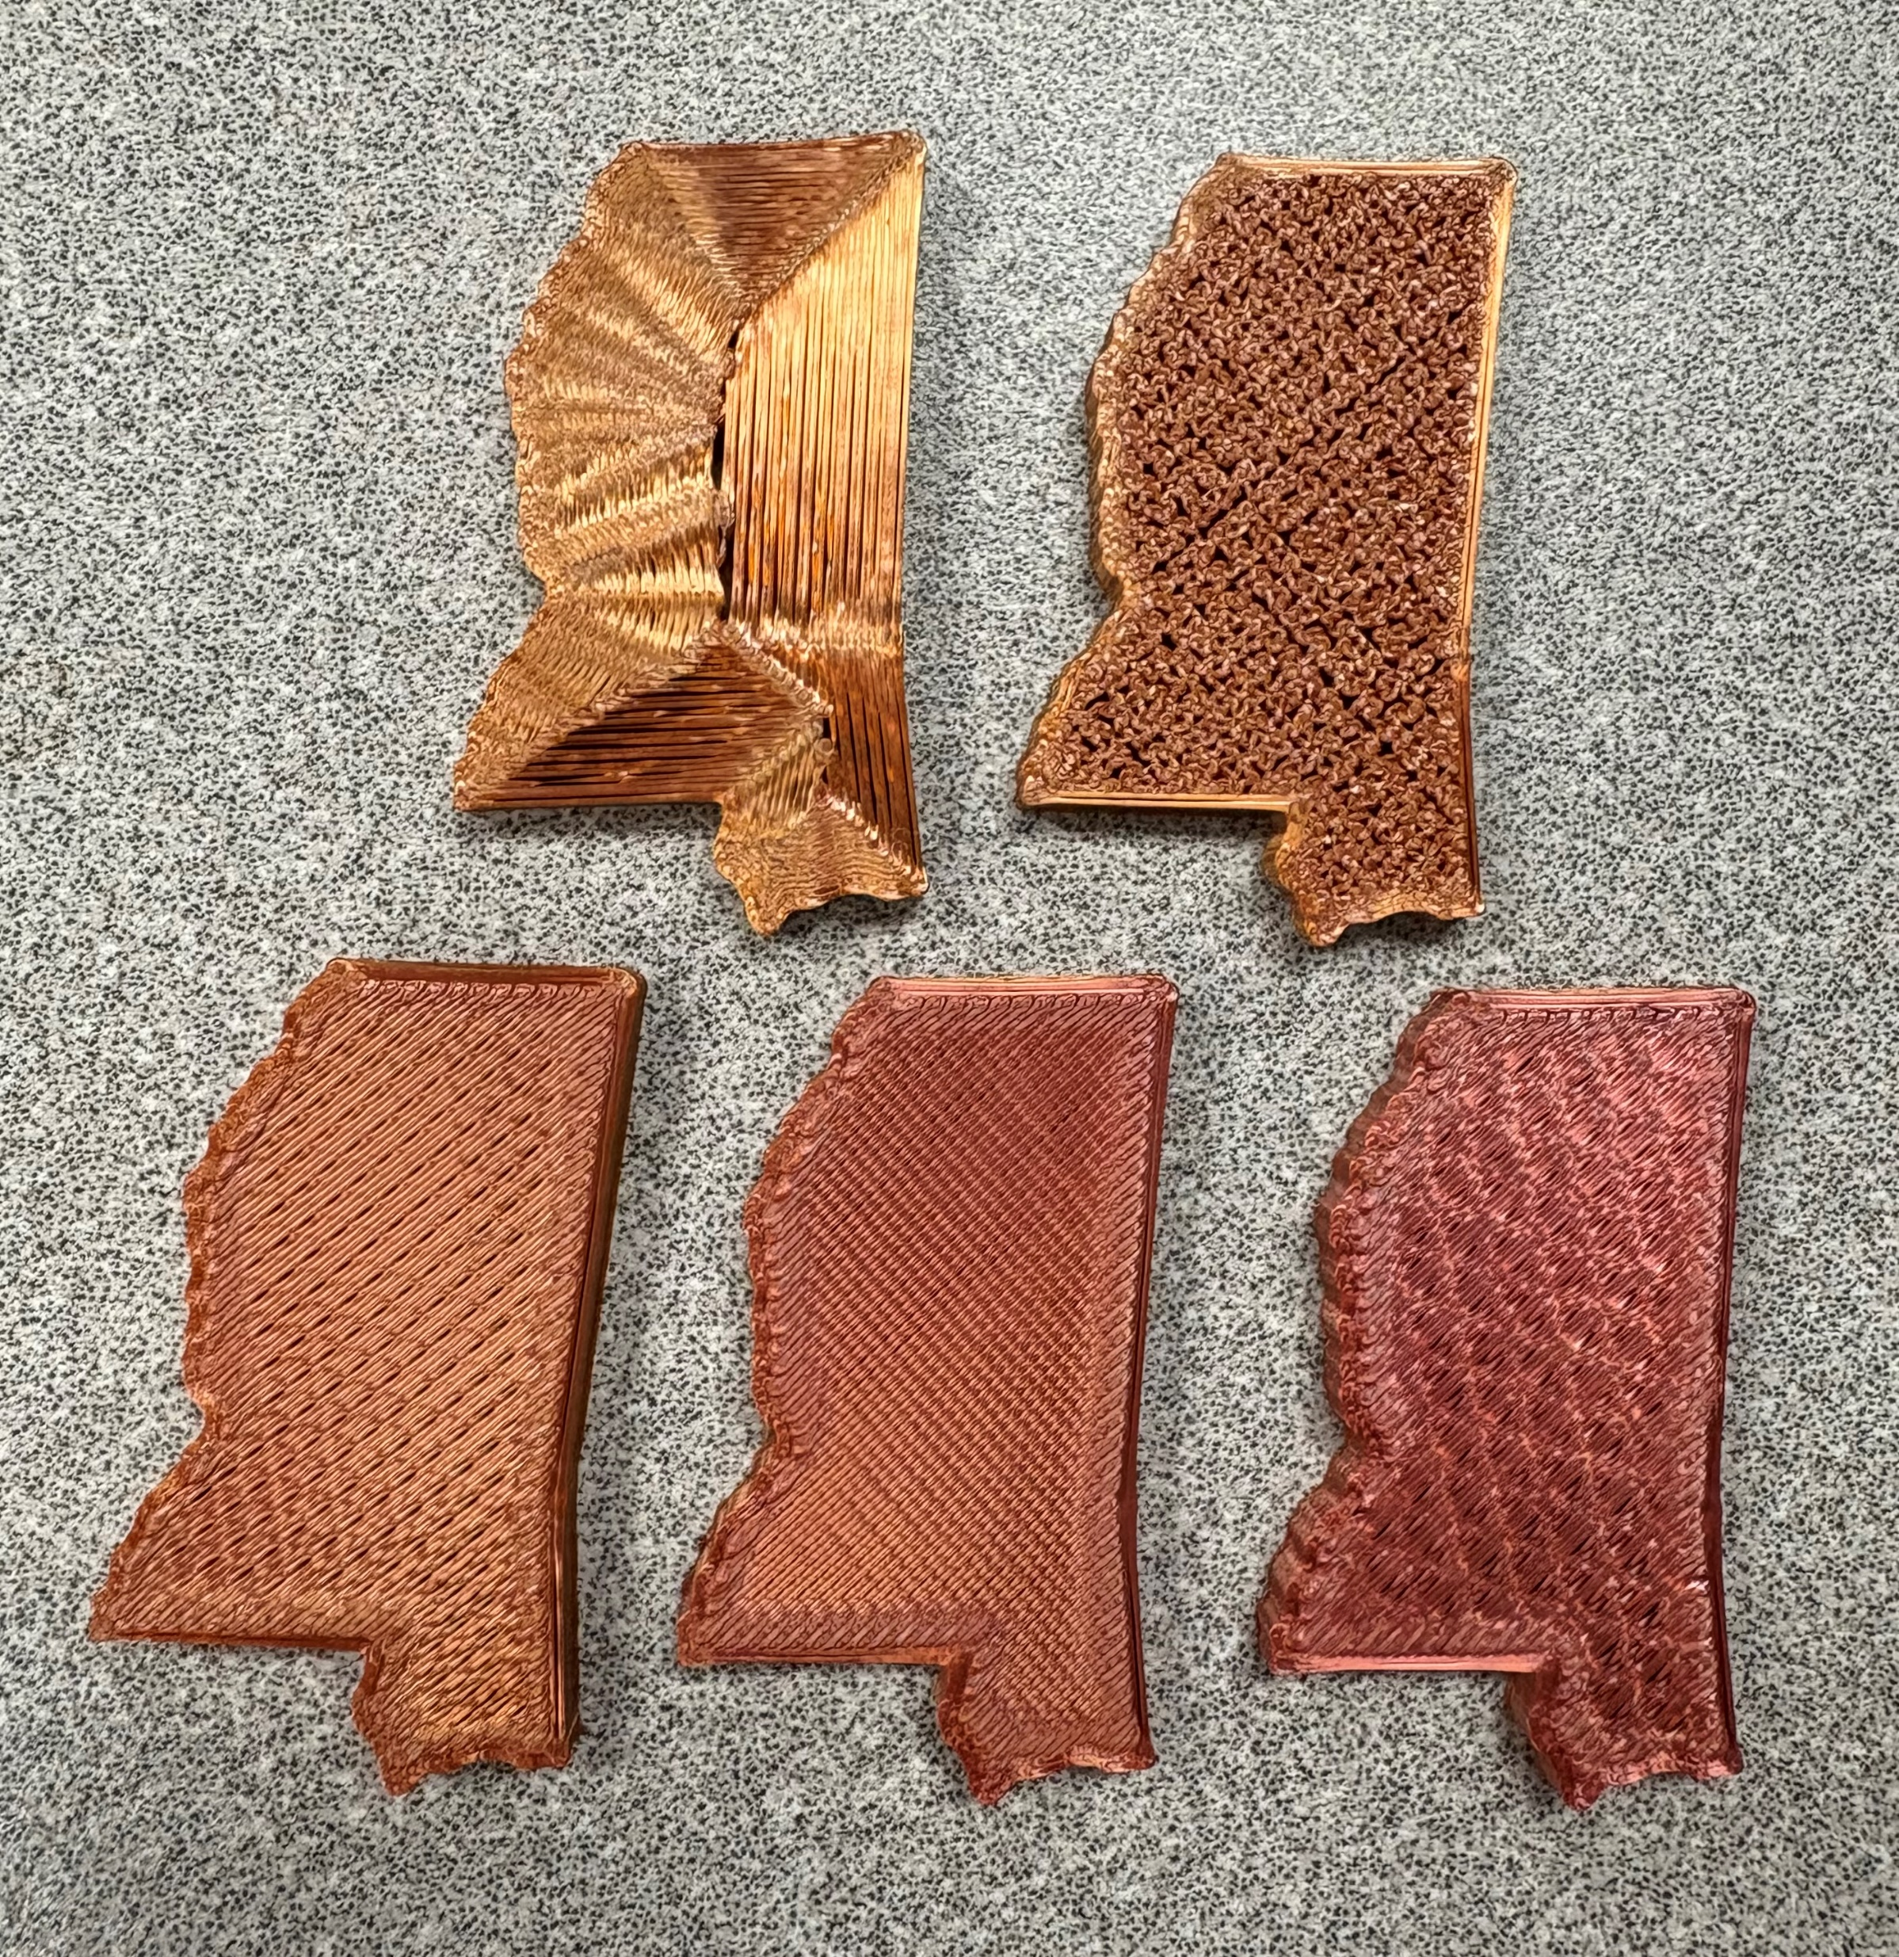
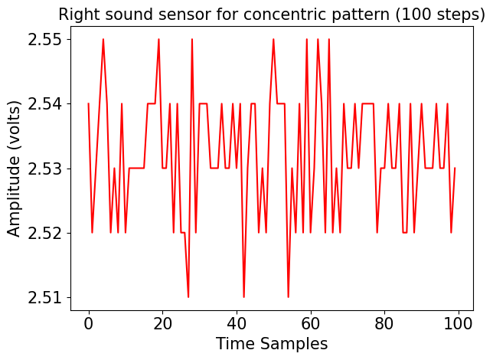
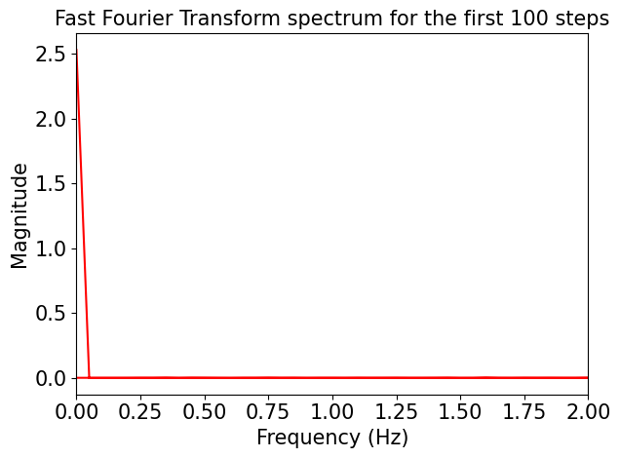
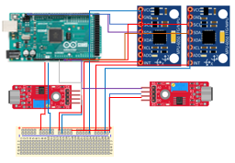
Infill Pattern Classification of Fused Filament Fabricated Components from Vibro-acoustic Signals with Machine Learning Algorithms
Andrew Jennings, Dongmin (Ethan) Kang, William Kalahar, and Minan Li
Instructor: Wenmeng Tian, Ph.D.
Department of Industrial & Systems Engineering, Mississippi State University
Objectives
Sensor Allocation and Experimental Setup
Results
Implemented a smart manufacturing system with the MakerGear CoreXY printer that collects multiple vibration and acoustic data while detecting infill patterns.
The system classifies five infill patterns up to 92.5% accuracy using different machine learning (ML) classifiers.
Infills used: Concentric, Hilbert Curve, Honeycomb, Rectilinear, and Triangle.
Provided specimen is in the shape of Mississippi with the dimensions (mm): 23.96 x 40.89 x 3.75.
One accelerometer was attached to the print bed and collected data in the Y direction.
The other accelerometer was attached to the nozzle and collected data in the Y direction.
The acoustic sensors were positioned to collect data from both sides of the nozzle.
Data acquired at 5 Hz using the Arduino Mega 2560 integrated with PronterFace and Python.
Chosen model parameter values
Method | Parameter Values
Decision Tree | Tree depth of 20
Random Forest | Same depth, 50 trees
MLP | 3 hidden layers with ReLU activation
Performance comparisons
Method | Training Accuracy (%) | Testing Accuracy (%)
Decision Tree | 100.00 | 92.50
Random Forest | 100.00 | 88.75
MLP | 94.06 | 92.50
Process Parameters | Values
Material | PLA
Layer height (mm) | 0.20
Infill density (%) | 50
Infill print speed (mm/s) | 200
Infill angle (degrees) | 45
Printing temperature (C) | 210
Build plate temperature (C) | 65
Nozzle diameter (mm) | 0.35
Filament diameter (mm) | 1.75
Classification report of MLP classifier
Infill pattern | Precision | Recall | F1 Score | Samples in Test Set
Concentric | 1.00 | 1.00 | 1.00 | 22
Hilbert | 0.78 | 0.93 | 0.85 | 15
Honeycomb | 0.90 | 0.69 | 0.78 | 13
Rectilinear | 0.95 | 1.00 | 0.97 | 18
Triangle | 1.00 | 0.92 | 0.96 | 12
No filament extrusion occurred at the first 30 seconds of the data collection, so these samples were eliminated.
All G-code was generated using PrusaSlicer 2.4.1
Sensor Selection
Model Framework
Conclusions
Vibration: The GY-521 MPU-6050 three axis accelerometer (one channel each)
Acoustic: The SY-M213 high sensitivity microphone (two analog channels)
1. Full signals are segmented into time windows of 100 steps.
2. Time windows are transformed into the frequency domain with Fast Fourier Transform
4. New dataset is split into train sets (80%) and test sets (20%).
Performance of all classifiers with various parameters are evaluated with test sets.
3. Statistical features are extracted from the frequency domains of each window.
5. Classifiers are trained with different ML algorithms.
1. Time Domain
2. Frequency Domain
Strengths
Robust vibro-acoustic data collection system across multiple channels using low-cost sensors.
Computationally inexpensive application of Fourier transforms and ML algorithms in classifying five infill patterns of the same print.
Weaknesses
Low sampling rate limits feature richness.
Manual under-sampling of data to account for class imbalance.
Hardware location and environmental factors introduced uncontrolled external interference.
Future Work
Introduce additional sensor modalities, such as thermocouples for temperature and cameras for grayscale or color imagery.
Increase number of underrepresented samples for improved ML training with the Synthetic Minority Oversampling Technique.
Wiring Diagram
4. Data Splitting
3. Extracted Features
Train: 320 samples (64 per class) | Test: 80 samples
Maximum value
Sum of coefficients
Mean of coefficients
Total variance
Peak value
Skew of coefficients
Kurtosis of coefficients
5. Machine Learning
References
All data and full implementation details are available on GitHub: https://github.com/ezy-8/InfillPatternClassifier_FFF
Method | Parameters
Decision Tree | Maximum depth
Random Forest | Number of estimators
Multi-Layer Perceptron (MLP) | Hidden layer sizes, activation function
Y. Fu, A. Downey, L. Yuan, A. Pratt, and Y. Balogun, “In situ monitoring for fused filament fabrication process: A review,” Additive Manufacturing, vol. 38, p. 101749, Feb. 2021, doi: 10.1016/j.addma.2020.101749.
P. K. Rao, J. (Peter) Liu, D. Roberson, Z. (James) Kong, and C. Williams, “Online Real-Time Quality Monitoring in Additive Manufacturing Processes Using Heterogeneous Sensors,” Journal of Manufacturing Science and Engineering, vol. 137, no. 6, p. 061007, Dec. 2015, doi: 10.1115/1.4029823.

